Slide 1
Health Equity Capstone Event

Slide 2
Purpose
Highlight accomplishments, lessons learned and next steps
Celebrate progress made since the inception of the Health Equity Learning Collaborative
Provide content for marketing those accomplishments beyond the conclusion of the Health Equity Learning Collaborative

Slide 3
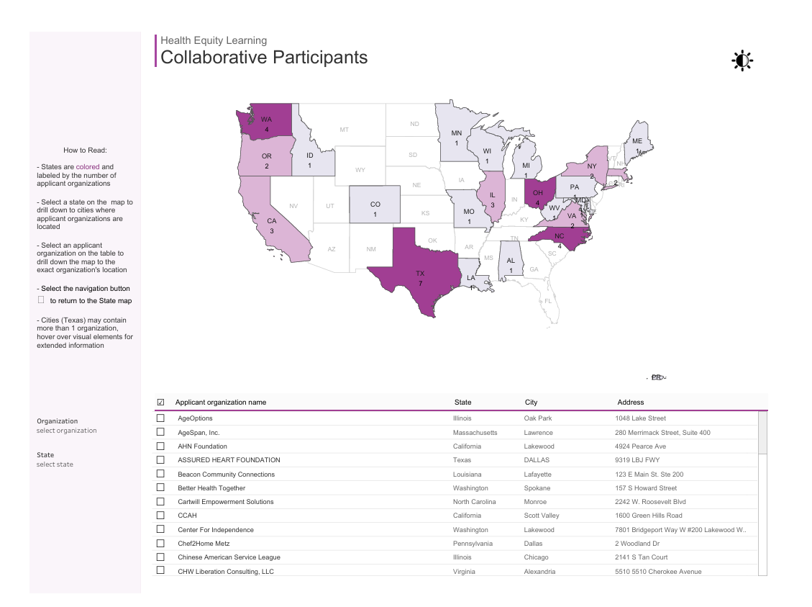
Benefits to Your Organization
Placement on the Health Equity map which will support overall marketing of your health equity efforts
HELC Participants | Partnership to Align Social Care

Slide 4
Instructions
Step 1. Prepare your Capstone
Step 2. Send your Capstone to HealthEquity@partnership2asc.org by the end of February
If you choose not to present a Capstone, your organization will be removed from the Health Equity map
Step 3. Be ready to share a 5-minute presentation of your Capstone during assigned date
If the date assigned does not work for you, please reach out to HealthEquity@partnership2asc.org

Slide 5
Assigned Dates for Your Capstone
March 6, 2025
March 20, 2025
SARCOA, Dothan, AL
AHN Foundation, Lakewood, CA
CCAH, Scott Valley, CA
LifeSpring Homenutrition, Lake Forest, CA
Denver Regional Council of Governments - Area Agency on Aging, Denver, CO
Health Empowerment Network of DC, Washington, DC
AgeOptions, Oak Park, IL
Chinese American Service League, Chicago, IL
Beacon Community Connections, Lafayette, LA
AgeSpan, Inc., Lawrence, MA
Somerville-Cambridge Elder Services, Somerville, MA
Maryland Living Well Center of Excellence, a Division of MAC, Inc. AAA, Salisbury, MD
Healthy Living for ME, Augusta, ME
Detroit Area Agency on Aging, Detroit, MI
Winona Health Foundation (Winona Community HUB), Winona, MN
Mid-America Regional Council, Kansas City, MO
Impact Health, Asheville, NC
Piedmont Triad Regional Council, Kernersville, NC
Quality Comprehensive Health Center, Charlotte, NC
Cartwill Empowerment Solutions, Monroe, NC
Health and Welfare Council of Long Island, Huntington Station, NY
Western New York Integrated Care Collaborative, Inc., Buffalo, NY
Partners for Advancing Community Health, Columbus, OH
The Foodbank, Inc., Dayton, OH
Timothy Freeman, MD, Center for Intellectual and Developmental Disabilities, Cincinnati, OH
Western Reserve Area Agency on Aging, Cleveland, OH
Oregon Wellness Network, Salem, OR
Project Access NOW (PANOW), Portland, OR
Chef2Home Metz, Dallas, PA
REMA, LLC (dba Sociants), San Juan, PR
Assured Heart Foundation, Dallas, TX
Houston Health Department / Harris County Area Agency on Aging, Houston, TX
The Health Collaborative, San Antonio , TX
Community Council of Greater Dallas, Dallas, TX
Community Health Worker Training Institute, Arlington, TX
The Network of Behavioral Health Providers, Houston, TX
YWCA San Antonio, San Antonio, TX
Virginia Community Health Worker Association, Richmond, VA
Better Health Together, Spokane, WA
Center For Independence, Lakewood, WA
Lucid Living (SafetyNet), Tacoma, WA
Washington State Department of Social and Health Services (WA DSHS), Olympia, WA
YMCA of Metropolitan Milwaukee, WI
The Arc of the Mid-Ohio Valley, Parkersburg, WV

Slide 6
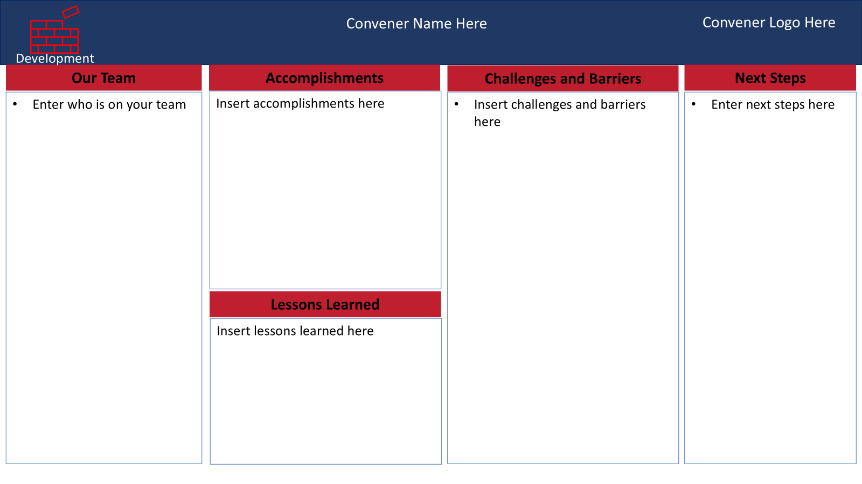
Preparation
Status | Definition
In Development | Building Partnerships Readiness to file a claim is greater than 6 months
In Progress | Readiness to claim is less than 6 months
In Implementation | Have filed at least one claim

Slide 7
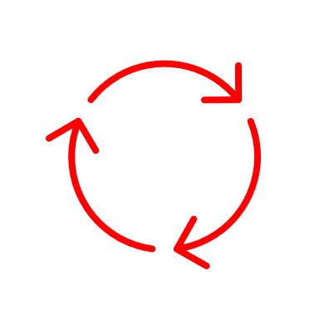
Implementation
Convener Name Here
Convener Logo Here
Our Team
Geographic Area
Accomplishments
Next Steps
Enter who is on your team
Insert geographic area here
Enter any accomplishments here
Enter next steps here
Target Populations
Insert target populations here
Services
Lessons Learned
Insert services here
Enter any lessons learned here

Slide 8
In Progress
Convener Name Here
Convener Logo Here
Our Team
Geographic Area
Accomplishments
Next Steps
Enter who is on your team
Insert geographic area here
Enter any accomplishments here
Enter next steps here
Target Populations
Insert target populations here
Services
Lessons Learned
Insert services here
Enter any lessons learned here

Slide 9
Development
Convener Name Here
Convener Logo Here
Our Team
Accomplishments
Challenges and Barriers
Next Steps
Enter who is on your team
Insert accomplishments here
Insert challenges and barriers here
Enter next steps here
Lessons Learned
Insert lessons learned here

Slide 10
Review
Step 1. Prepare your Capstone
Step 2. Send your Capstone to HealthEquity@partnership2asc.org by the end of February
If you choose not to present a Capstone, your organization will be removed from the Health Equity map
Step 3. Be ready to share a 5-minute presentation of your Capstone during assigned date
If the date assigned does not work for you, please reach out to HealthEquity@partnership2asc.org

