Slide 1

Partnership to Align Social Care (Partnership)
July 2023

Slide 2

Co-Chairs, Partnership to Align Social Care
Timothy P. McNeill
Freedmen’s Health
tmcneill@freedmenshealth.com
202-344-5465
June Simmons
Partners in Care Foundation
jsimmons@picf.org
818-837-3775 x101
www.Partnership2ASC.org

Slide 3
Partnership to Align Social Care
Mission:
  To enable successful partnerships and contracts between health care and community care networks to create efficient and sustainable ecosystems needed to provide individuals with holistic, person-centered social care that demonstrates cultural humility.
Vision:
  A sustainably resourced, community-centered social care delivery system that is inclusive of all populations and empowered by shared governance and financing, multistakeholder accountability, and federal/state/local policy levers.

Slide 4
Co-Designing a Social Care Delivery System
Group of diverse stakeholders collaborating to co-design partnerships between health care and community-based organizations (CBOs)
  Includes senior leaders from CBOs, health plans, health systems, national associations, and federal leaders engaged as liaisons
  Includes leadership and feedback from community leaders throughout the process to elevate the voice of the community
  Incorporates and supports the perspectives, needs, and priorities of historically marginalized communities to promote accountability and guarantee a focus on health equity

Slide 5

Co-Designing a Social Care Delivery System
11 Health Plans/Systems
15+ National Thought Leading Organizations
20+ CBOs and CBO Networks
5 Federal Agency Partners
20+ National Associations
8 Funders

Slide 6
Principles of an Equitable Health and Social Care Ecosystem
Partnership to Align Social Care
CBOs
AgeSpan
Aging & In-Home Services of Northeast Indiana, Inc.
Bay Aging
Community Catalyst
Denver Regional Council of Govt
Detroit Area Agency on Aging
Healthy Living for Maine
Houston AAA/ADRC & Houston Health Department
Mid-America Regional Council
Ohio Association of AAAs
Partners in Care Foundation
Pathways Community HUB Institute
Piedmont Triad Regional Council
Region IV Area Agency on Aging
Trellis
Western NY Integrated Care Collaborative
YMCA of Metropolitan Milwaukee
YMCA of the USA
Associations/Agency
ADvancing States*
AHIP
AMA
American Academy of Family Physicians
American Hospital Association
America’s Physician Groups
Assoc of Asian Pacific Cmty Health Organizations
Assoc of Community Affiliated Plans
Food is Medicine Coalition
Lutheran Services in America
National Association of Medicaid Directors*
National Association of Community Health Centers
Social Current
Special Needs Plan Alliance
USAging
Administration for Community Living (ACL)**
Center for Medicare & Medicaid Innovation (CMMI)**
Center for Medicaid & CHIP Services (CMCS)**
Office of the National Coordinator for Health IT (ONC)**
*Non-Voting Member/Liaison \ **Federal Liaisons
Other
Camden Coalition of Healthcare Providers
Center for Health Care Strategies
Center for Practical Bioethics
Clearlink Partners
Comagine Health
Concert Health
Duke-Margolis Center for Health Policy
Epiphany LLC
Eviset
Freedmen’s Health
Gravity Project
Health Care Transformation Task Force
Independent Living Research Utilization
Independent Living Systems, LLC
Manatt, Phelps & Phillips, LLP
Rush University Medical Center
Winona Health
Health Plans
Aetna CVS Health
Elevance Health
CareSource
Centene
Humana
United Healthcare
Well Care of New Jersey
Health Systems
CommonSpirit Health
Kaiser Permanente
Trinity Health
Mount Sinai

Slide 7



Streamline Contracting
Facilitate Expanded Social Care Billing
Promote Community Care Hubs
Implementing
Co-Designed Social Care Delivery System Changes
Notes:
As part of this work, the Partnership to Align Social Care has developed and is disseminating numerous resources for multi-sector stakeholders aimed at improving alignment between the health and social care ecosystems (HSCE). These include, but are not limited to, resources to help:
Streamline Contracting by leveraging and augmenting existing CBO resources to provide tools for health care payers to identify and pursue contracts with CBOs and CCHs;
Promote Community Care Hubs by developing shared expectations of CCH functions and capacities and enable emerging CCHs to identify strengths and gaps in capacity; and
Facilitate Expanded Social Care Billing by analyzing and building upon existing leading practices to expand the landscape of opportunities for CBOs and CCHs to efficiently code and bill for social care labor and services.

Slide 8
Building Sustainable CBO Network Capacity
Workgroups address priority issues:
  Core competencies/approach for qualifying CBO networks
  Encouraging widespread use of existing and proposed billing codes
  Streamlined contracting process between health plans/systems and CBOs
  Enabling organization and financing strategies to support and sustain CBO networks

Slide 9







Funders

Slide 10
Phase One: Planning
Partnership to Align Social Care:
Collaboration and co-design to enable and support efficient and sustainable health and social care ecosystems
Operationalizing co-design and collaboration concepts and forums
Fundraising from multiple industry stakeholders
Responding to emerging sector priorities
Engaging with other key stakeholder groups
Enhancing visibility and awareness of Partnership priorities and activities
Planning for implementation and future priorities

Slide 11
Phase Two: Testing & Implementation
Complete & Validate Deliverables
Focus on Data Security & Best Practices
Expand Opportunities in Value-Based Payment Arrangements to Promote Health Equity
Build Awareness & Engagement
Provide Technical Assistance & Capacity Building

Slide 12
Community Care Hub
The Partnership’s Community Care Hub Workgroup has developed the following definition for a Community Care Hub. This definition may continue to be updated:
A community-focused entity that organizes and supports a network of community-based organizations providing services to address health-related social needs. A Community Care Hub centralizes administrative functions and operational infrastructure, including but not limited to, contracting with health care organizations, payment operations, management of referrals, service delivery fidelity and compliance, technology, information security, data collection, and reporting.
A Community Care Hub has trusted relationships with and understands the capacities of local community-based and healthcare organizations and fosters cross-sector collaborations that practice community governance with authentic local voices.

Slide 13
History of Federal Investments to Support Hub Models
  The Federal Government has been testing various models to support community-clinical linkages to improve health outcomes.
  The evaluation from these models have led to current policy in support of Community Care Hub models.
  There is increased interest in the adoption of Community Care Hub models to leverage economies of scale for implementing sustainable community-level interventions that align with healthcare.

Slide 14
Hub Model and Non-Clinical Service Delivery Investment Timeline
2012:
Community Care Transitions Program (CCTP)
2014:
CMMI Demonstration: YMCA of the USA for National DPP
2017: Accountable Health Communities Model
2018:
CHRONIC Care Act – Special Supplemental Benefits (SSBCI)

Slide 16
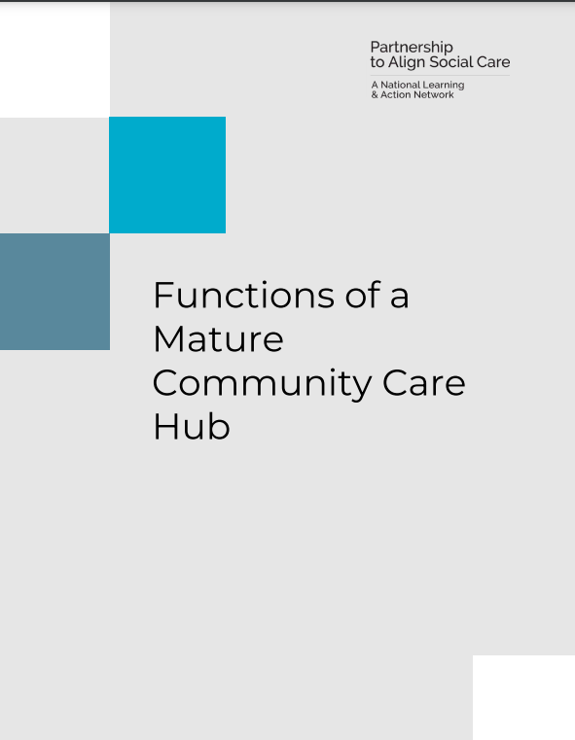
  Report:
  Reflective of cross-sector, inclusive, extensive process to identify CCH capacities across the country
  Demonstrates the evolution of CCH functions and capacities
  Intended as a roadmap toward CCH Model
  Inform self-assessment of strengths, gaps, and opportunities for growth
  Outlines functions that CCH is responsible for ensuring happen by CCH or Community Care Network Members
Link to Resource: https://www.partnership2asc.org/wp-content/uploads/2023/05/Functions-of-a-Mature-Community-Care-Hub-May-2023.pdf

Slide 17
Current Partnership Resources
Working with Community Care Hubs to Address Social Drivers of Health: A Playbook for State Medicaid Agencies
Community Care Hub Primer: Background, Evolution, and Value Proposition of Working with a Local CBO Network Led by a Community Care Hub
Slide Deck: Evolution of the Community Care Hub Model to Align Social Care with Healthcare
Functions of an Advanced Community Care Hub
Partnership to Align Social Care Webinar Series
  Cultivating Community Care Hubs, An Evolving Model to Improve Alignment between Health and Social Care Services (slides)
  Integrating Community Care Hubs into Efforts to Address SDOH: A Playbook for State Medicaid Agencies (slides and additional resources)
  Leveraging Multi-Payer Partnerships with Community Care Hubs to Build Equitable Health and Social Care Ecosystems (slides)
Webinar Series: Leveraging Community Care Hubs to Foster Health and Social Care Alignment
  Leadership, Governance, and Business Development
    Slides & Recording Available
  Contract Administration & Compliance and IT & Security
    Slides & Recording Available
  Network Recruitment, Engagement, and Support
    Slides & Recording Available
Notes:
Additionally, here are some links (assuming these will be included in the follow-up materials as well) to existing Partnership resources and materials.

Slide 18
Pending Partnership Resources
Community Care Hub Workgroup | Contracting Workgroup | Billing/Coding Workgroup | General Partnership Resources
Talking about equitable health and social ecosystems: A guide for clear and effective language A screening tool for communities (new/existing CCHs) and guidance to resources, tools, best practices, and opportunities for growth. Written documentation of the stakeholders & recommendations to formally recognize and promote the development of networks led by qualified CCHs: by advocacy/policy, hospitals/health plans/health systems, associations, foundations, and community | Four-Part Series: Partnerships with community-based organizations: Opportunities for health plans to create value A Health Plan’s Guide to Paying CBOs for Social Care Operationalizing contracts: Methods payers can employ to improve collaboration with community-based organizations Developing the scope of work Other Resources Template contracts and annotated guides to contracting A report summarizing the major findings and recommendations of the working group, including recommendations for implementation support | Health Related Social Needs Care Coordination Labor and Direct Interventions list for Coding Environmental scan of the current landscape of billing codes to support interventions to address Health Related Social Needs Guiding principles for EDI operations and operations and interoperability needs for CBO networks | Framework for Creating a Sustainable and Equitable Health and Social Care Ecosystem Additional Asset Mapping Underway
Notes:
This is a brief look at some of the upcoming resources that the Partnership to Align Social Care plans to release this summer, including the suite of Contracting workgroup resources that we are starting to discuss today.
Additionally, we look forward to disseminating additional tools to support the implementation of CCHs and CCNs across the country as well as look at resources to facilitate coding and billing for social needs care labor and services.

Slide 19
Framework for Creating a Sustainable and Equitable Health and Social Care Ecosystem
Seeks to create a common vision of an equitable HSCE. The framework includes six different domains that represent the major elements of the HSCE:
  Workforce
  Data sharing and measurement
  Financing options for system and services
  Services for health-related social needs
  Multi-stakeholder alignment and governance
  CBO Network formation

Slide 20
Principles of an Equitable Health and Social Care Ecosystem
Social conditions significantly affect health and wellbeing, at the individual and population level
CBOs provide important social care services, inclusive of care coordination
The integration of social care and healthcare is best managed through a multi-stakeholder health and social care ecosystem (HSC Ecosystem)
CBOs and other community representatives must play a central role in the design and governance of the local HSC Ecosystem
The HSC Ecosystem requires payment for contracted services through an operational infrastructure, such as a community care hub
The HSC Ecosystem should fairly compensate CBOs for social care services through blending and braiding of existing funding and new healthcare payment models, consistent with regulations

Slide 21


How to Get Involved in the Partnership…
Sign up for our email list: https://www.partnership2asc.org/sign-up/
Follow the Partnership on social media:
Reach out directly to:
  Support the Partnership
  Ask about getting involved in leadership/workgroup activities
  Share your expertise/experiences
www.linkedin.com/company/partnership-to-align-social-care
@partnership2asc

Slide 22
Co-Chairs
June Simmons
Partners in Care Foundation
jsimmons@picf.org
818-837-3775 x101
Timothy P. McNeill
Freedmen’s Health
tmcneill@freedmenshealth.com
202-344-5465
Director
Autumn Campbell
acampbell@Partnership2ASC.org
202-805-6202
@Partners2ASC

